Slide 1

About the Presentations
The presentations cover the objectives found in the opening of each chapter.
All chapter objectives are listed in the beginning of each presentation.
You may customize the presentations to fit your class needs.
Some figures from the chapters are included. A complete set of images from the book can be found on the Instructor Resources disc.

Slide 2
Network+ Guide to Networks 6th Edition
Chapter 1
An Introduction to Networking

Slide 3
Objectives
List the advantages of networked computing relative to stand-alone computing
Distinguish between client/server and peer-to-peer networks
List elements common to all client/server networks

Slide 4
Objectives (cont’d.)
Describe several specific uses for a network
Identify some of the certifications available to networking professionals
Identify the kinds of skills and specializations that will help you excel as a networking professional

Slide 5
Why Use Networks?
Network
Group of computers and devices
Connected by transmission media
Stand-alone computer
Not connected to other computers
Uses local software and data
Advantages of networks
Device sharing by multiple users
Saves money and time
Central network management

Slide 6
Types of Networks
Models vary according to:
Computer positioning
Control levels over shared resources
Communication and resource sharing schemes
Network models
Peer-to-peer
Client/server

Slide 7
Peer-to-Peer Networks
Direct computer communication
Equal authority
Individual resource sharing
May share resources
May prevent access to resources
Traditional model
Two or more general purpose computers:
Capable of sending and receiving information to and from every other computer

Slide 8
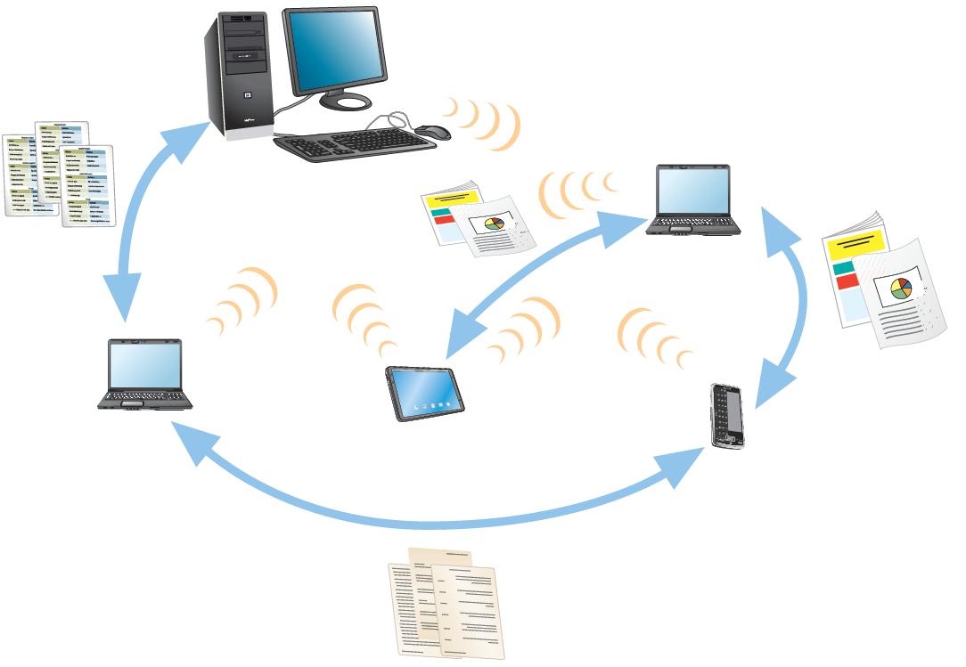
Peer-to-Peer Networks (cont’d.)
Figure 1-1 Resource sharing on a simple peer-to-peer network
Courtesy Course Technology/Cengage Learning

Slide 9
Peer-to-Peer Networks (cont’d.)
Advantages
Simple configuration
Less expensive
Compared to other network models
Disadvantages
Not flexible
Not necessarily secure
Not practical for large installations

Slide 10
Peer-to-Peer Networks (cont’d.)
Resource sharing method
Modify file sharing controls
User responsibility
Not centrally controlled
Access may not be uniform or secure
Environments
Small home or office
Large networks using the Internet
Gnutella, Bitcoin, original Napster
BitTorrent software

Slide 11
Client/Server Networks
Server
Central computer
Facilitates communication and resource sharing
Clients
Personal computers
Also known as workstations
Central resource sharing controlled by server
Sharing data, storage space, devices
No direct sharing of client resources

Slide 12
Client/Server Networks (cont’d.)
Computer roles
Server
Clients
Run local applications
Store data locally
Use server shared applications, data, devices
Use server as intermediary
Communication
Switches or routers

Slide 13
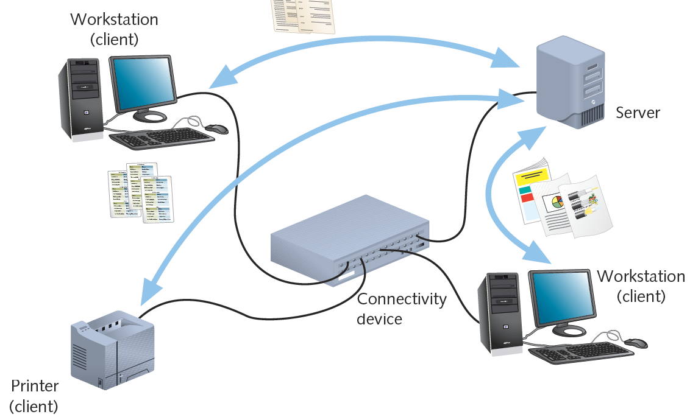
Client/Server Networks (cont’d.)
Figure 1-2 Resource sharing on a client/server network
Courtesy Course Technology/Cengage Learning

Slide 14
Client/Server Networks (cont’d.)
Server requirement
Network operating system
Manages client data, resources
Ensures authorized user access
Controls user file access
Restricts user network access
Dictates computer communication rules
Supplies application to clients
Server examples
UNIX, Linux, Microsoft Server 2008 R2, MAC OS X Server

Slide 15
Client/Server Networks (cont’d.)
Server features relative to clients
More memory, processing, storage capacity
Equipped with special hardware
Provides network management functions
Disadvantages relative to peer-to-peer networks
Complex design and maintenance

Slide 16
Client/Server Networks (cont’d.)
Advantages relative to peer-to-peer networks
User credential assigned from one place
Multiple shared resource access centrally controlled
Central problem monitoring, diagnostics, correction capabilities
Optimized to handle heavy processing loads
Can connect many computers on a network
More scalable

Slide 17
LANs, MANs, and WANs
LAN (local area network)
Network confined to a relatively small space
1980s
LANs became popular as peer-to-peer based
Today
Larger and more complex client/server network
MAN (metropolitan area network)
Connects clients and servers from multiple buildings
Uses different transmission media and technology than LAN

Slide 18
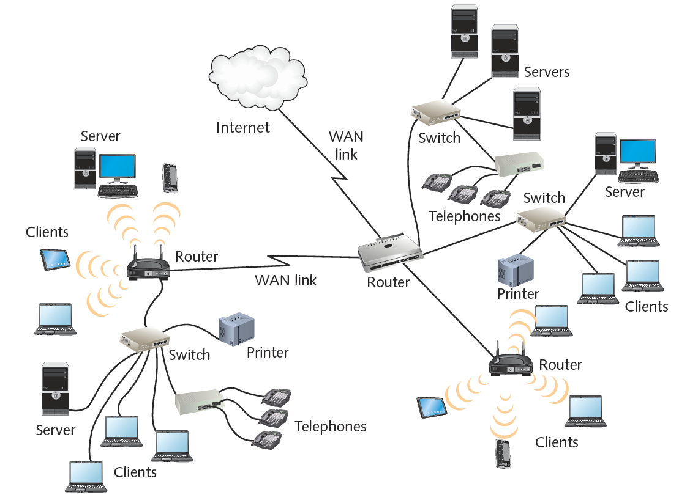
LANs, MANs, and WANs (cont’d.)
Figure 1-3 Interconnected LANs
Courtesy Course Technology/Cengage Learning

Slide 19
LANs, MANs, and WANs (cont’d.)
WAN (wide area network)
Connects two or more geographically distinct LANs or MANs
Uses different transmission methods and media than LAN
Network connection
Separate offices in same organization
Separate offices in different organizations

Slide 20
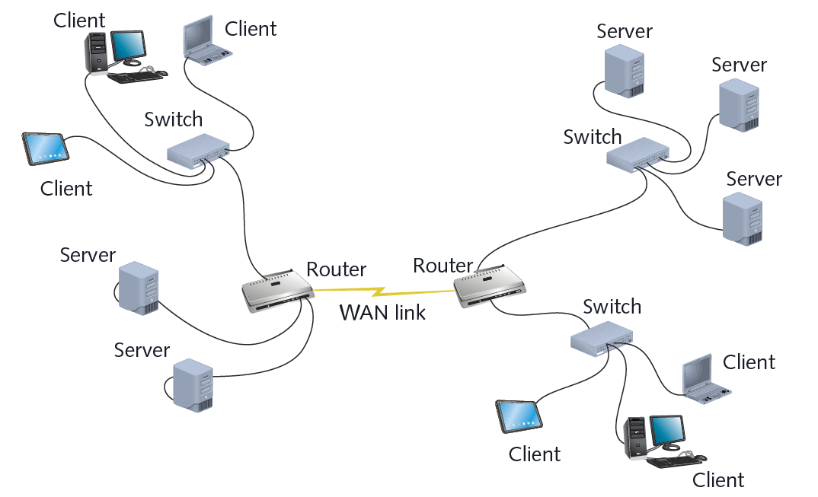
LANs, MANs, and WANs (cont’d.)
Figure 1-4 A simple WAN
Courtesy Course Technology/Cengage Learning

Slide 21
Elements Common to Client/Server Networks
Client
Network computer requesting resources or services from another network computer
Client workstation human user
Client software installed on workstation
Server
Network computer managing shared resources
Runs network operating software
Workstation
Personal computer
May or may not be connected to network

Slide 22
Elements Common to Client/Server Networks (cont’d.)
NIC (network interface card)
Device inside computer
Connects computer to network media
Allows communication with other computers
NOS (network operating system)
Server software
Enables server to manage data, users, groups, security, applications, and other networking functions

Slide 23
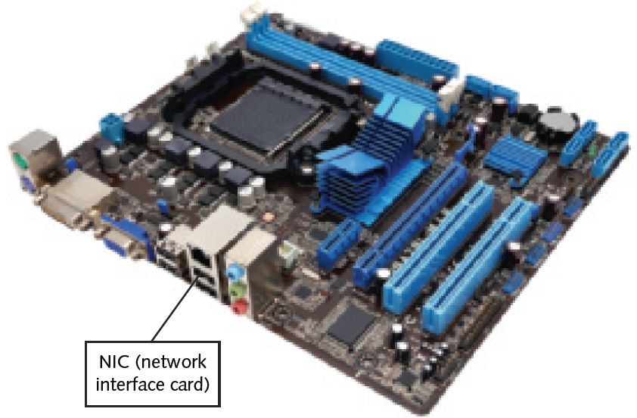
Elements Common to Client/Server Networks (cont’d.)
Figure 1-5 A NIC (network interface card)
Courtesy Course Technology/Cengage Learning

Slide 24
Elements Common to Client/Server Networks (cont’d.)
Host
Computer
Enables network resource sharing by other computers
Node
Client, server, or other device
Communicates over a network
Identified by unique network address
Connectivity device
Allows multiple networks or multiple parts of one network to connect and exchange data

Slide 25
Elements Common to Client/Server Networks (cont’d.)
Segment
Group of nodes
Uses same communications channel for traffic
Backbone
Connects segments and significant shared devices
“A network of networks”
Topology
Computer network physical layout
Ring, bus, star or hybrid formation

Slide 26
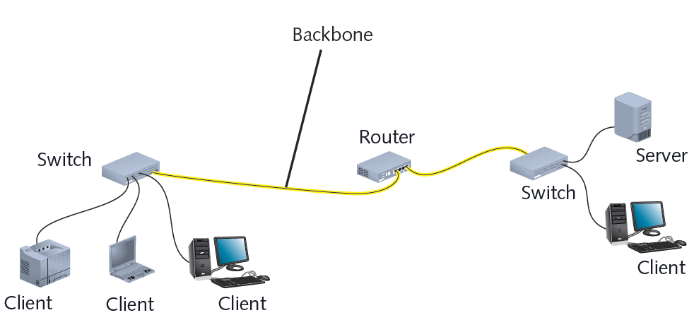
Elements Common to Client/Server Networks (cont’d.)
Figure 1-6 A LAN backbone
Courtesy Course Technology/Cengage Learning

Slide 27
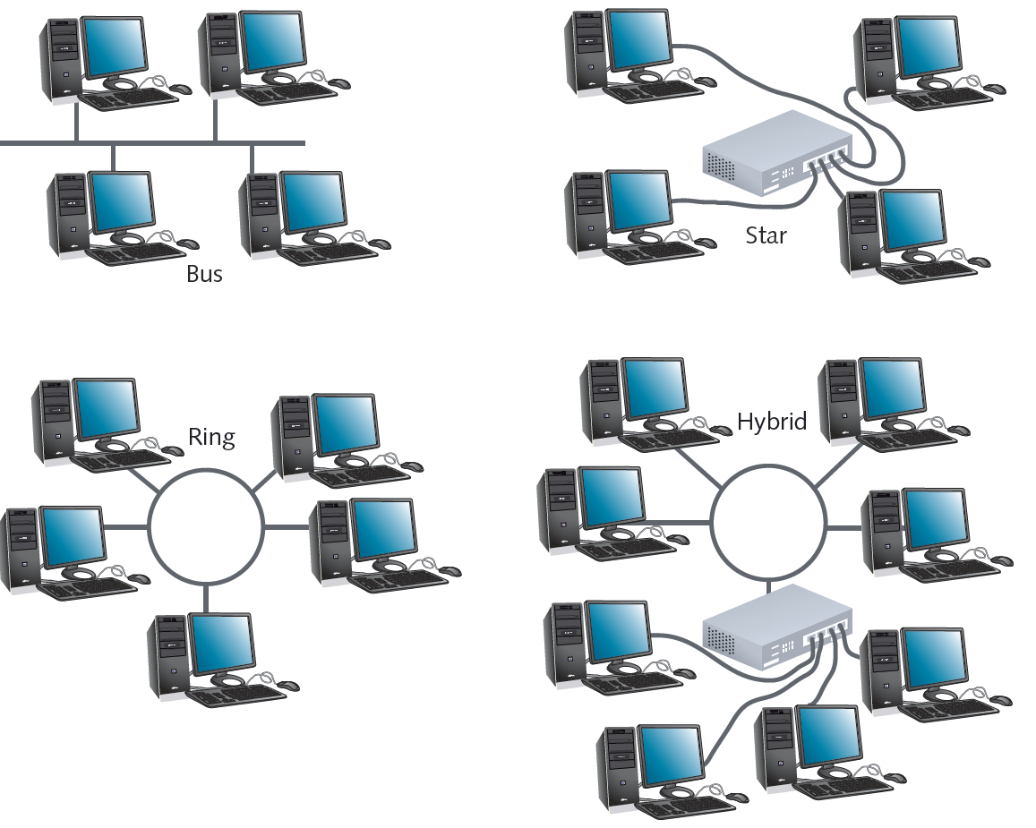
Figure 1-7 Common network topologies
Courtesy Course Technology/Cengage Learning

Slide 28
Elements Common to Client/Server Networks (cont’d.)
Protocol
Standard method or format for communication between networked devices
Packet
Distinct data units exchanged between nodes
Addressing
Scheme for assigning unique identifying number to every node
Transmission media
Means through which data is transmitted and received

Slide 29
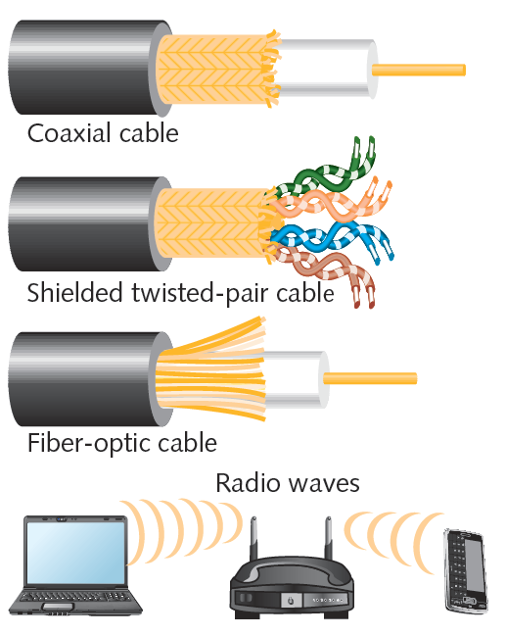
Figure 1-8 Examples of network transmission media
Courtesy Course Technology/Cengage Learning

Slide 30
How Networks Are Used
Network services
Functions provided by a network
E-mail
Printer sharing
File sharing
Internet access and Web site delivery
Remote access capabilities
Voice (telephone) and video services
Network management

Slide 31
File and Print Services
File services
Capability of server to share data files, applications and disk storage space
File server
Provides file services
File services provide foundation of networking
Print services
Share printers across network
Saves time and money

Slide 32
Access Services
Allow remote user network connection
Allow network users to connect to machines outside the network
Remote user
Computer user on different network or in different geographical location from LAN’s server
Network operating systems include built-in access services

Slide 33
Access Services (cont’d.)
Provide LAN connectivity when WAN connection is not cost-effective
External staff can diagnose problems
Allow external users to use network resources and devices
Same as if logged on to office workstation

Slide 34
Communications Services
Convergence
Offering multiple types of communications services on the same network
Unified communications
Centralized management of multiple network-based communications
Mail server
Computer responsible for e-mail storage and transfer

Slide 35
Communications Services (cont’d.)
Additional tasks of mail servers
Intercept spam
Handle objectionable content
Route messages according to rules
Provide Web-based client for checking e-mail
Notify administrators or users if certain events occur
Schedule e-mail transmission, retrieval, storage, maintenance
Communicate with mail servers on other networks
Mail server runs specialized mail server software

Slide 36
Internet Services
Web server
Computer installed with appropriate software to supply Web pages to many different clients upon demand
Other Internet services
File transfer capabilities
Internet addressing schemes
Security filters
Means for directly logging on to other Internet computers

Slide 37
Management Services
Small network management
Single network administrator
Today’s larger network management
Centrally administered network management tasks

Slide 38
Management Services (cont’d.)
Important network management services
Traffic monitoring and control
Load balancing
Hardware diagnosis and failure alert
Asset management
License tracking
Security auditing
Address management
Backup and restoration of data

Slide 39
Becoming a Networking Professional
Job market
Many job postings for computer professionals
Expertise levels required vary
To prepare for entering job market:
Master general networking technologies
Select and study areas of interest
Hone communication and teamwork skills
Stay abreast of emerging technologies
Consider professional certification
Get to know others in your field

Slide 40
Mastering the Technical Challenges
Skills to acquire
Installing, configuring, troubleshooting network server and client hardware and software
Understanding characteristics of transmission media
Understanding network design
Understanding network protocols
Understanding how users interact with network
Constructing a network with clients, servers, media, and connectivity devices

Slide 41
Mastering the Technical Challenges (cont’d.)
Pick one or two areas of concentration
Specialties currently in high demand
Network security
Convergence
In-depth knowledge about one or more NOSs
UNIX, Linux, MAC OS X Server, Microsoft Windows Server 2008 R2
Network management
Wireless network design
Configuration of routers and switches
Centralized data storage and management

Slide 42
Developing Your “Soft Skills”
Soft skills
Not easily measurable
Important to networking projects
Examples of soft skills
Customer relations
Oral and written communications
Dependability
Teamwork
Leadership abilities

Slide 43
Pursuing Certification
Certification process
Mastering specific material
Hardware system, operating system, programming language, software application
Proving mastery
Pass exams
Professional organizations
CompTIA
Network+
Vendors
Microsoft , Cisco

Slide 44
Pursuing Certification (cont’d.)
Benefits
Better salary
Greater opportunities
Professional respect
Access to better support

Slide 45
Finding a Job in Networking
Job research methods
Search the Web
Check local newspaper’s Web site
Visit a career center
Network with like-minded professionals
Attend career fairs
Enlist a recruiter

Slide 46
Joining Professional Associations
Benefits of professional associations
Connect with people having similar interests
New learning opportunities
Specialized information access
Tangible assets (free goods)
Access to publications
Technical workshops and conferences
Free software, pre-release software
Hardware lab access

Slide 47
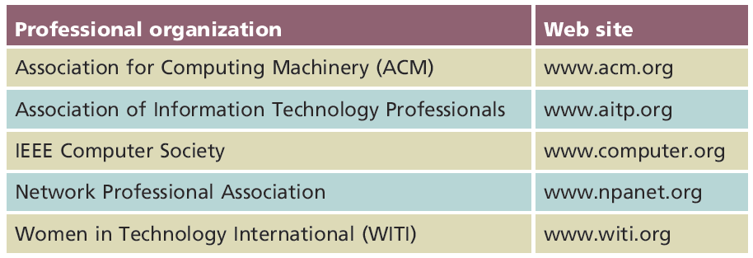
Joining Professional Associations (cont’d.)
Table 1-1 Some networking organizations
Courtesy Course Technology/Cengage Learning

Slide 48
Summary
Network
Group of connected computers and other devices
Types of networks include peer-to-peer and client/server networks
LANs, MANs, and WANs describe different sizes of networks
May use different transmission media and technology
Networks provide a wide range of services
Examples: file and print sharing

Slide 49
Summary (cont’d.)
Network management services centrally administer management tasks on a network
Examples: hardware problem diagnosis, license tracking
Job preparation
Master broad networking skills
Choose one or two specialty areas
Consider benefits of certification

